Slide 1
Registration and setup course for logins and Websites of the TU Dresden
Fakultät Umweltwissenschaften Fachrichtung Hydrowissenschaften
FSR Hydrowissenschaften

Slide 2
What‘s your status?
Did everybody configure their ZIH login and change the password?
Was everybody already on SELMA?
Is there anybody who already did their login for “eduroam”?
Did you find your modules on OPAL already?

Slide 3
What will be shown?
ZIH-Login – registration at TU server
Set up WLAN "eduroam"
SELMA – Management of your University data
Uni Mail
OPAL – lecture documents
Registration for sport courses
LSK Online – language courses
HISQIS – exams and notes
Microsoft Office as student

Slide 4
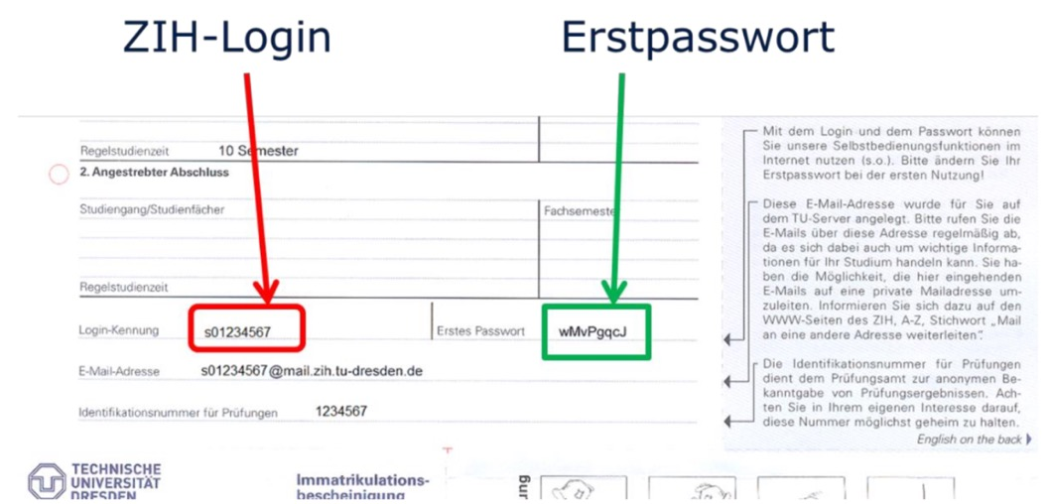
ZIH Login
Most important login within the online system of the TU Dresden!
Every student gets their ZIH-login through the enrolment papers, there’ll be your personal login and corresponding “on time password”.
“on time password”

Slide 5
creating a new password:
login at: https://tud.link/ammp
→ password management → change password
login allows access to:
    personal TU-email
    using TU-WLAN “eduroam”
    using the PC pool
    VPN usage
    TU cloudstore usage
    identification on many websites as a student (e.g. nextbike)

Slide 6
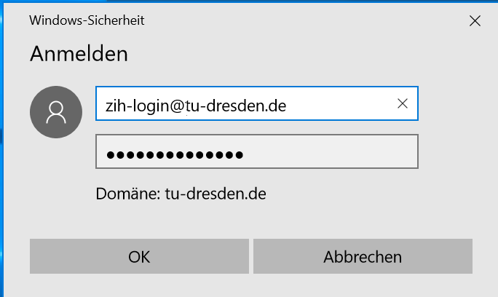
WLAN "eduroam"
choose WLAN “eduroam”
create own WLAN password:
https://tud.link/z2pp
login with “ZIH-Login@tu-dresden.de”
and own password
4. If that doesn’t work …
WLAN setup guide:
https://tud.link/zmk0

Slide 7
VPN: Virtual Private Network
access on university internal websites and documents from home
within SLUB/university: access to these websites through eduroam
VPN setup guide:
https://tud.link/g6mf

Slide 8
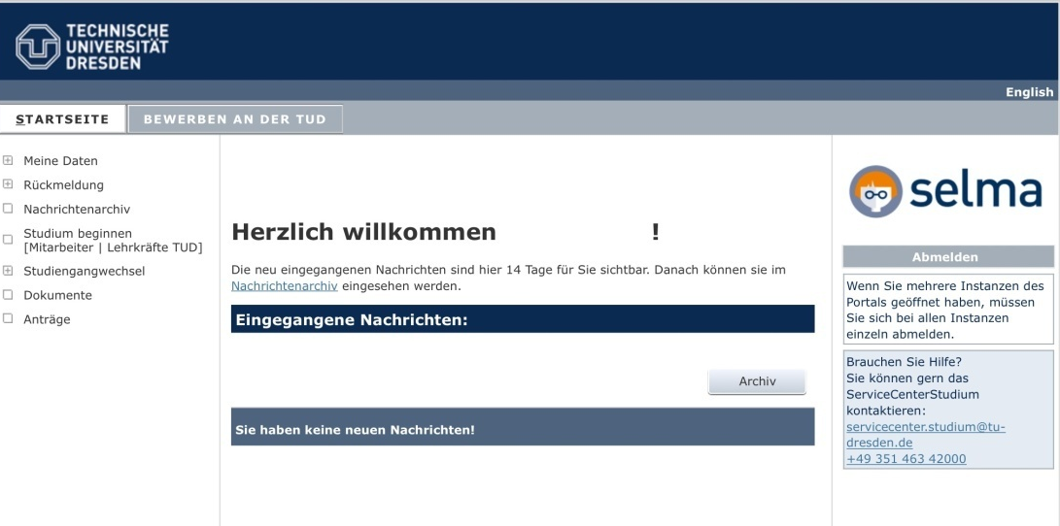
SELMA
→ manages your personal data on the TU server
→ e.g. your enrolment papers & some other papers in digital form
It is planned for SELMA to replace HISQIS at some point in the future.
access "Selma TUD“:
https://tud.link/olu1
login with ZIH-Login
3. access to personal data and
papers in the respective
menu points

Slide 9
Uni Mail
to exchange internal mails, e.g. emails from lecturers and other university
access through the following link: https://tud.link/xh6h
setup forwarding to other mail addresses:
https://tud.link/kpng
Tutorials for different clients and mobile devices:
https://tud.link/gvex

Slide 10
OPAL
“online platform for academic teaching and learning”
→ scriptures, lecture & exercise materials
login ZIH-Login
finding your courses/course selection:
→ course name
→ abbreviation of the lecture (to be found within module descriptions)
→ names/TU-pages of the lecturers
→ specialty pages of the hydrosciences

Slide 11

access to the materials partially through subscriptions in time
some materials = password protected
→ given at the first lecture of a semester.
https://tud.link/pkxu , einloggen mit ZIH-Login

Slide 12
Sports courses
= offered by the DHSZ (or DUSC, “Dresden university sports centre”):
https://tud.link/980t
use the course “Account for faster registration” beforehead, because of limited participants, some are fully booked within minutes
even if courses are already full, enrolling in the waiting lists is worthwhile
Registration: starting at 12th October, 2022 at 5 p.m.

Slide 13
LSK Online –Language courses
registration, deregistration, managing and grades as well as attendance certificate of the language courses
https://tud.link/pkxu , login with ZIH-Login
Registration:
→ choose language→ choose level(for higher levels of the languages, entrance test are often necessary)
DATES:
Registration: 1st October 2022, starting 00:00
Start of lectures: 17th October 2022
Notes:
Für den Unterrichtsbeginn nochmal kurz vorher schauen | bisher keine Angabe online
LSK ist seit diesem Sem auch auf OPAL

Slide 14
HISQIS
Plattform for exam registration and grade overview
https://tud.link/tjcv, login with ZIH-Login
binding exam registration = approx. 3 weeks before the exams, possible for 2 weeks, afterwards not anymore
→ if problems occur: contact examination office:
https://tud.link/9era
3. cancellation = possible until the day before the exam, after doing so registering again isn’t possible for the current semester

Slide 15
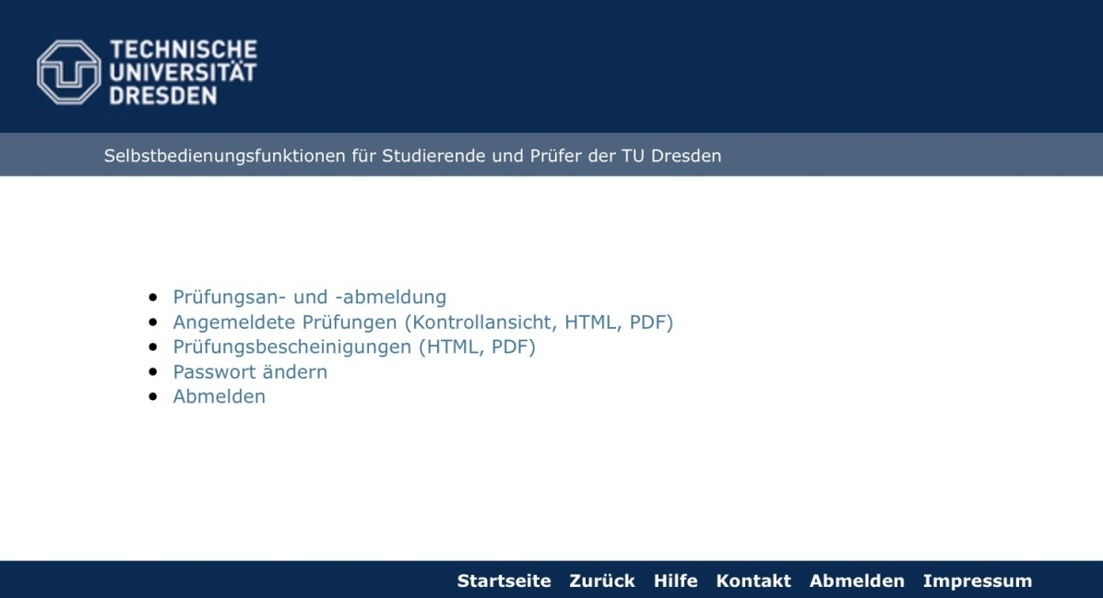
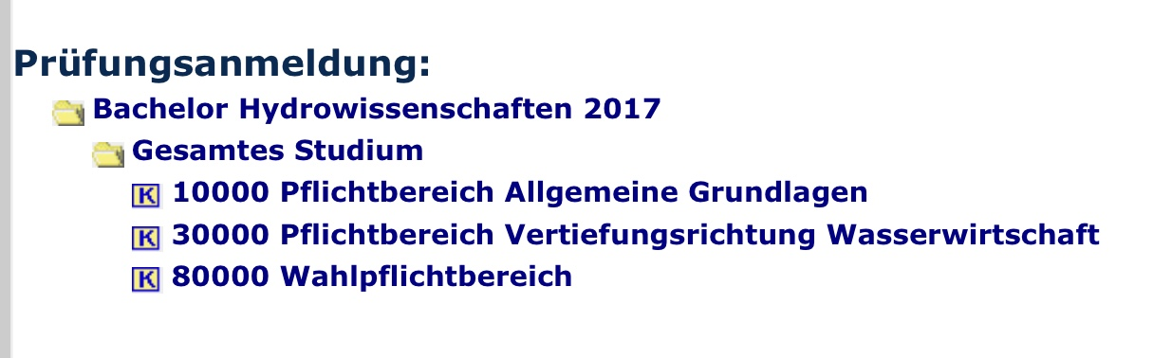

Slide 16
Microsoft Office
As a student at the TU Dresden a Microsoft Office package can be downloaded and used free of charge at CAMPUS SACHSEN.
included are: Word, PowerPoint, Excel, Outlook, Access
Campus Sachsen:
→ https://tud.link/bvm5
→ login through ZIH-login
→ choose Office 365 for students, registered for one year, afterwards the registration has to be renewed
→ follow download instructions

Slide 17

If any questions occur feel free to contact us directly at the faculty students’ council of hydro sciences
https://tud.link/yg7e

