Slide 1
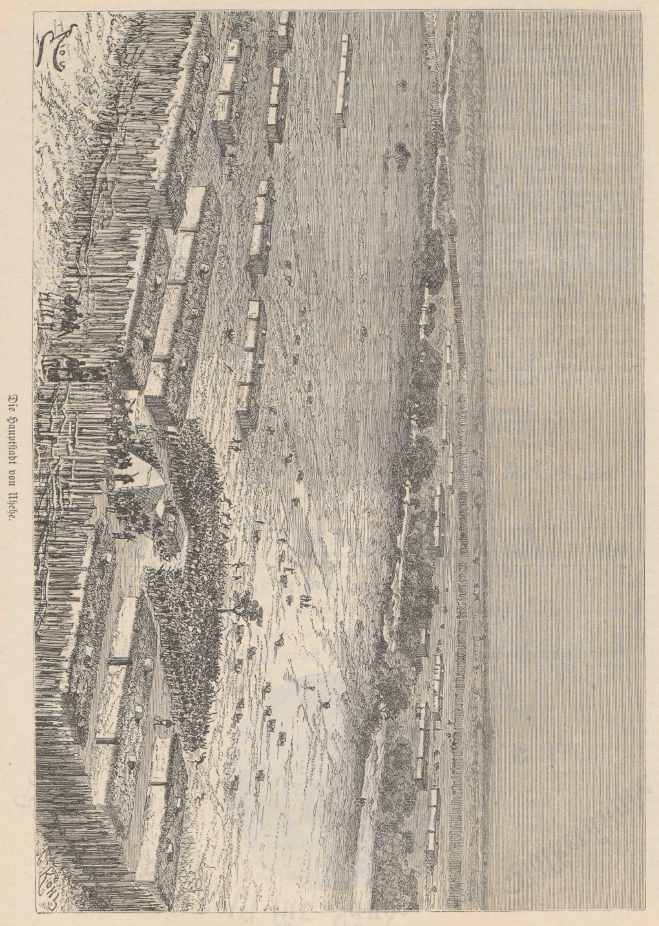

COLONIAL HISTORY, LOCAL CULTURE AND COMMUNITY LIVELIHOODS.
Shared Heritage and the Sustainable Development
Goals in Iringa, Tanzania.
Young scientist’s workshop on
UNESCO World Heritage and the
Sustainable Development Goals
UNESCO Chair in International Relations
TU Dresden, February 4, 2019
Jan Küver
BTU Cottbus-Senftenberg/University of Iringa
jkuever@fahariyetu.net

Slide 2
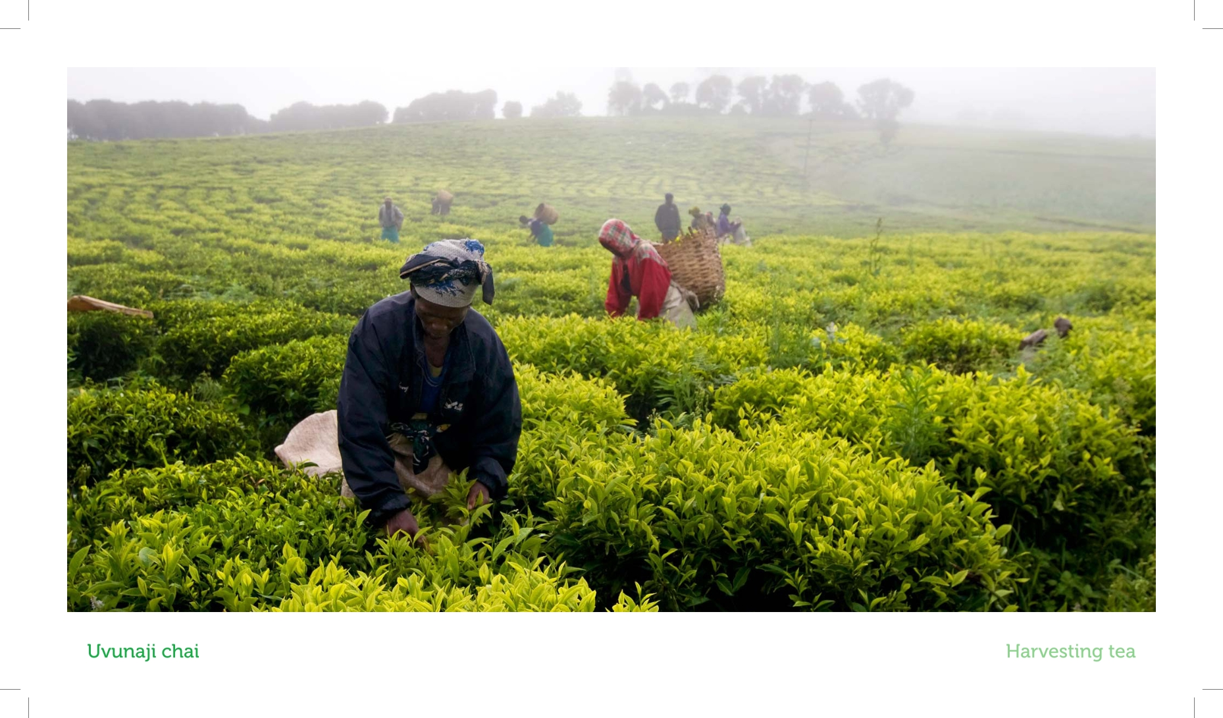
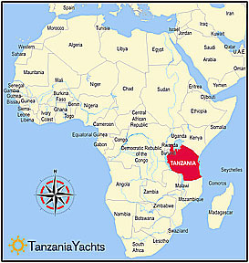
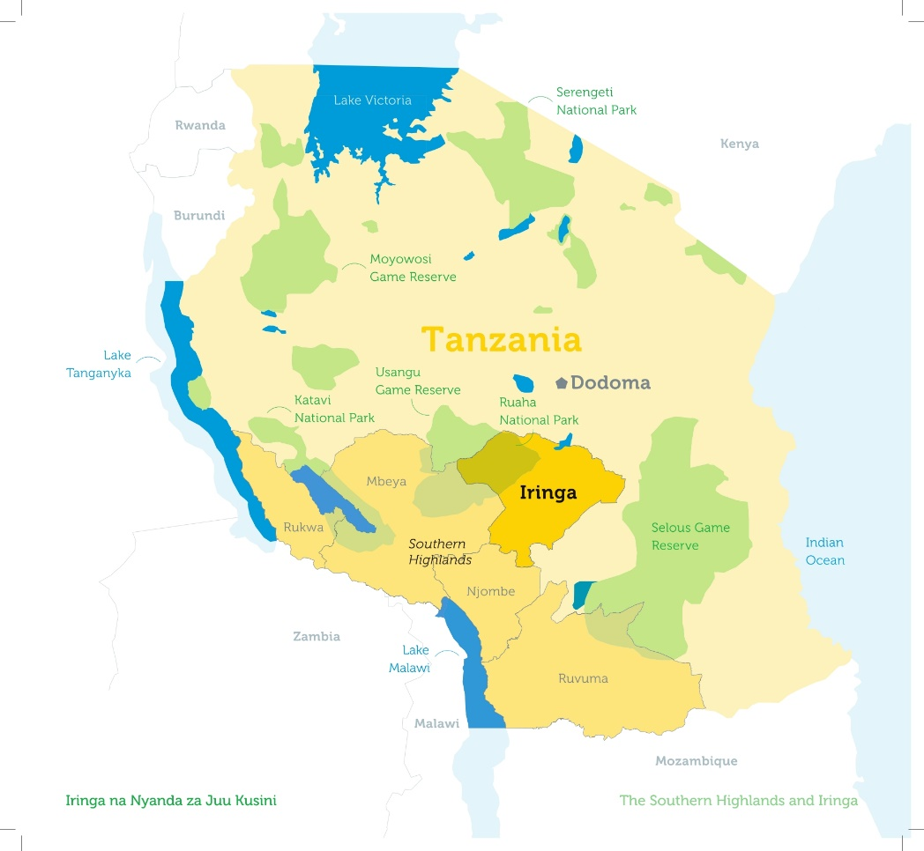
ZOOMING INTO IRINGA
Higland plateau of 1500-2000 m
Population Iringa Region approx. 1 Million
Population Iringa Town approx. 150.000
Wildlife tourism and historical/cultural heritage sites

Slide 3
IRINGA HERITAGE RESOURCES
Outstanding heritage to develop: Pre-colonial history and anti-colonial resistance
Formation of the Hehe Kingdom and expansion to current borders
Peak of power under Chief Mkwawa and centralization in fortified „Old Iringa“
The German-Hehe wars: Annihilation of the first „Schutztruppen-“expedition, shelling and fall of „Old Iringa“, establishment of German „New Iringa“, guerilla resistance, death of Mkwawa,
Contemporary traces, sites and buildings of „shared history“

Slide 5
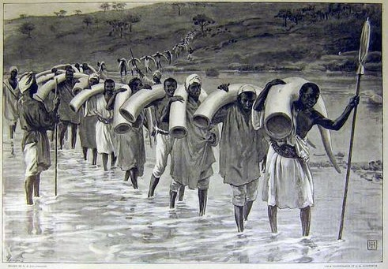

Slide 6
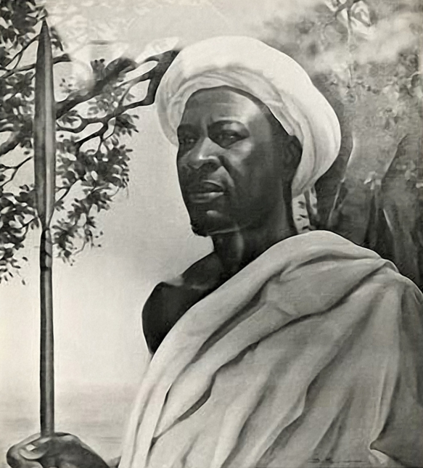

Slide 7
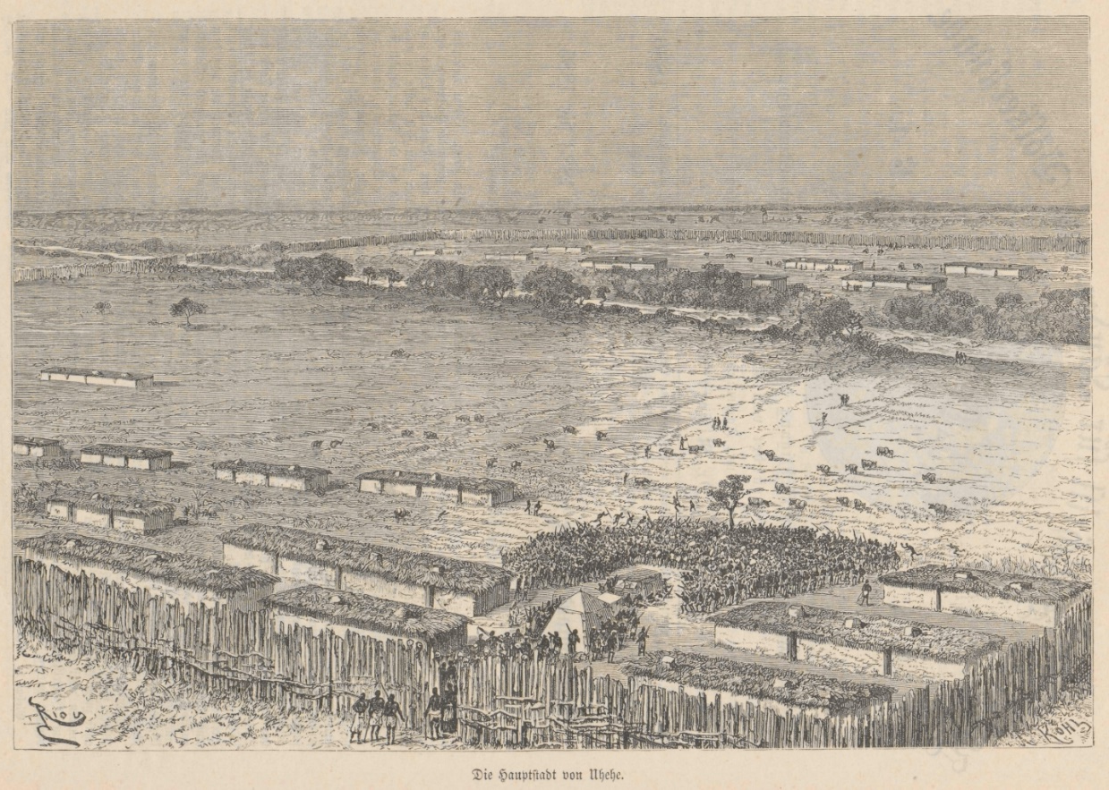

Slide 8
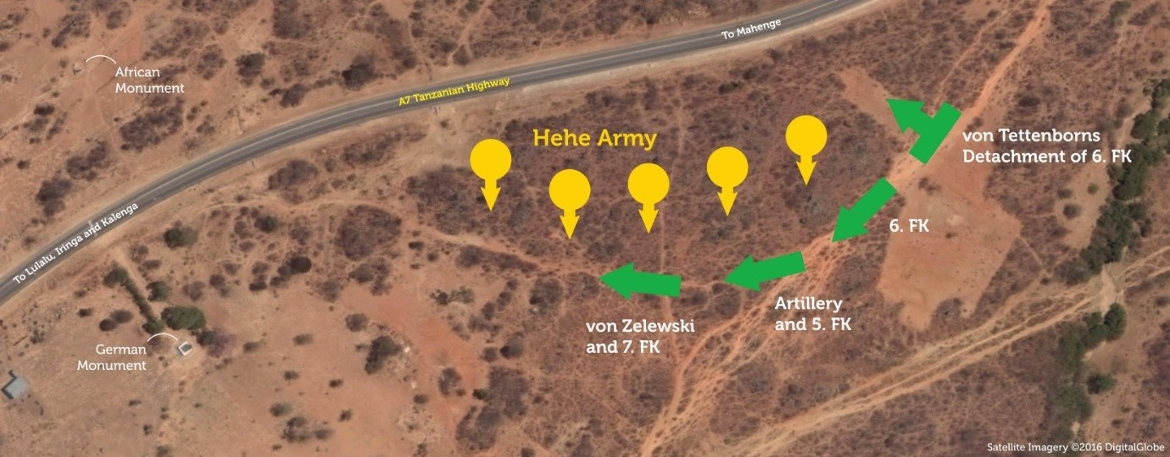

Slide 9
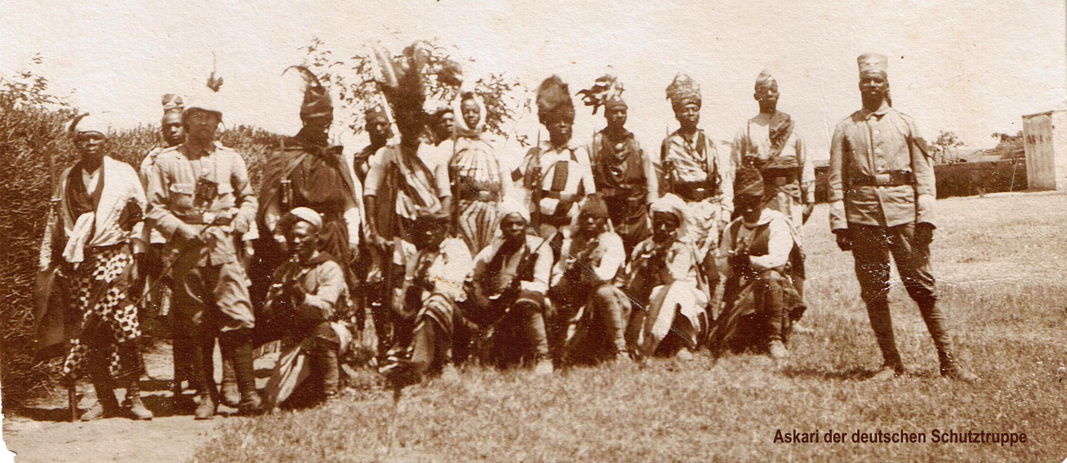

Slide 10
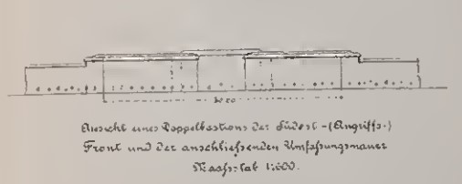

Slide 11
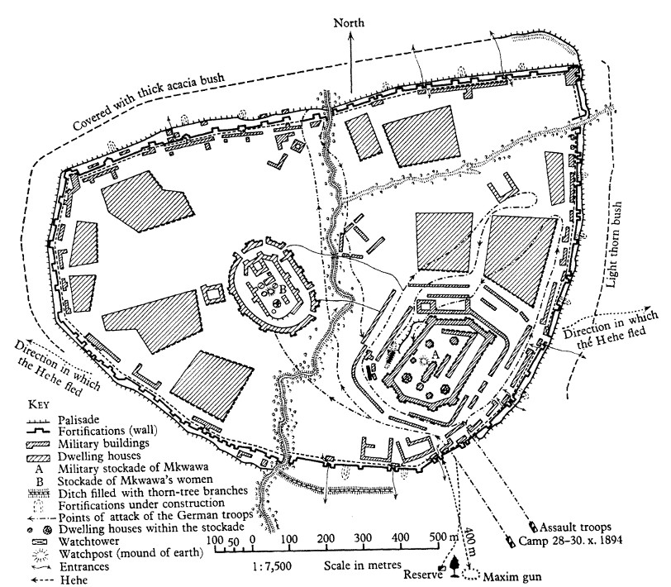

Slide 12
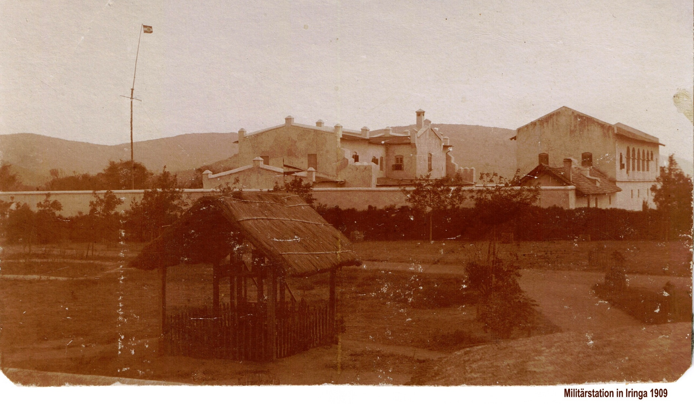

Slide 13
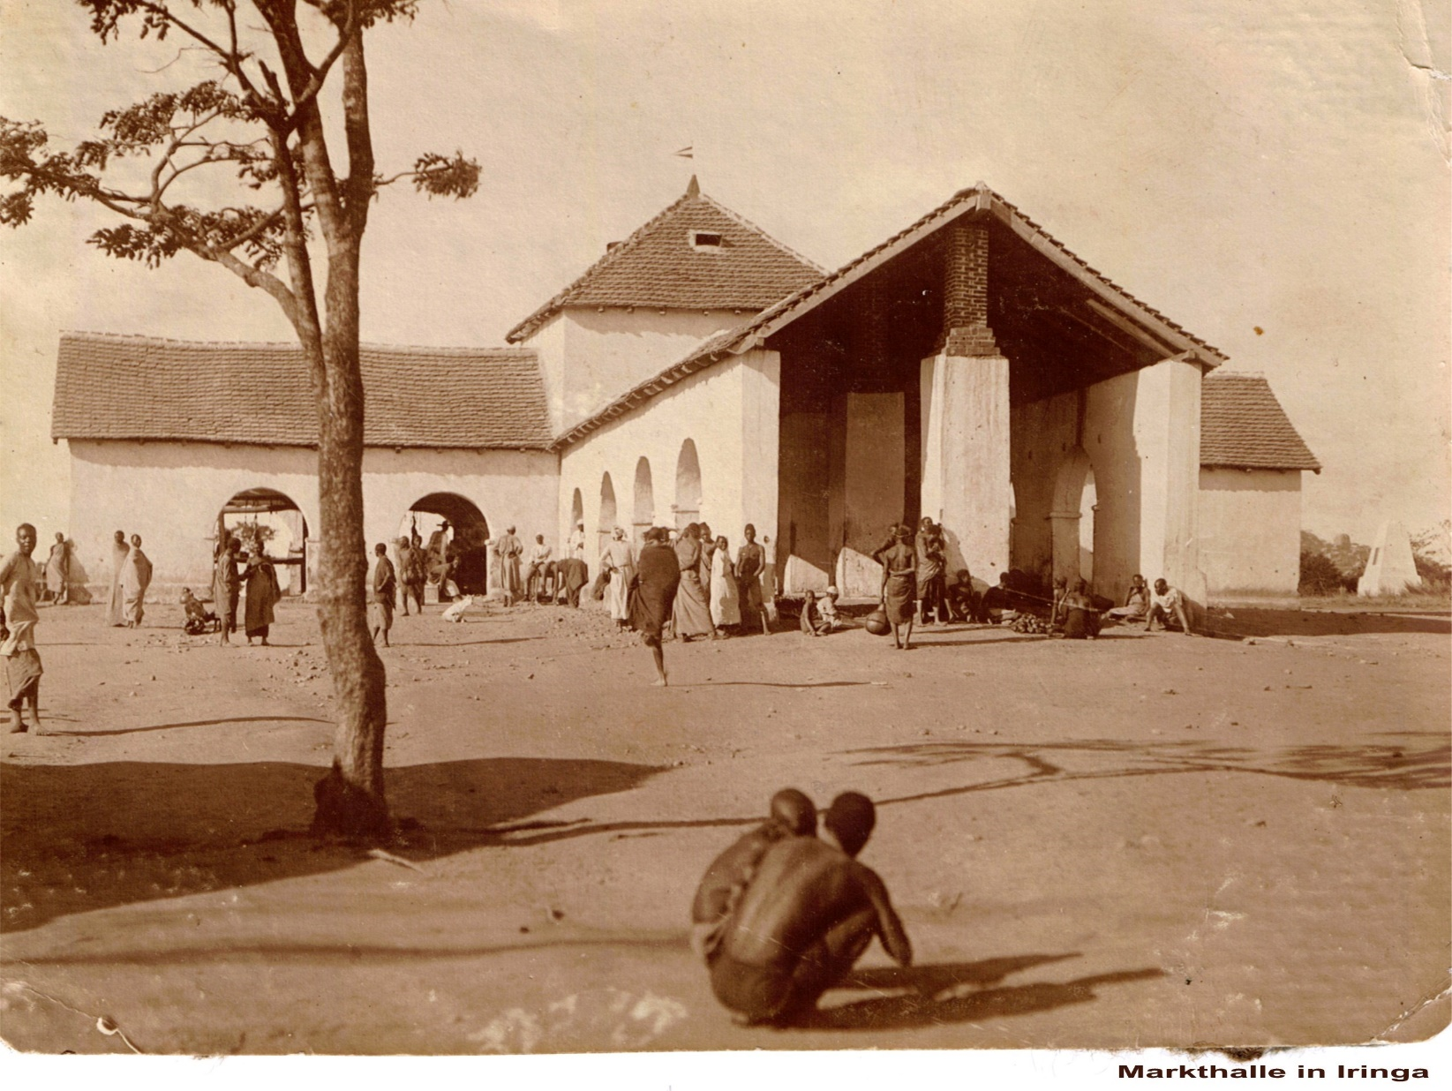

Slide 14
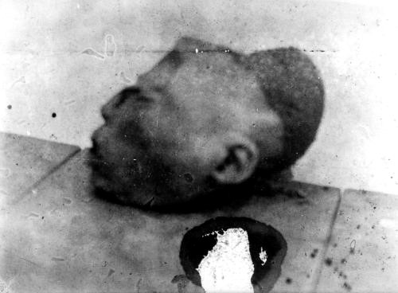

Slide 15
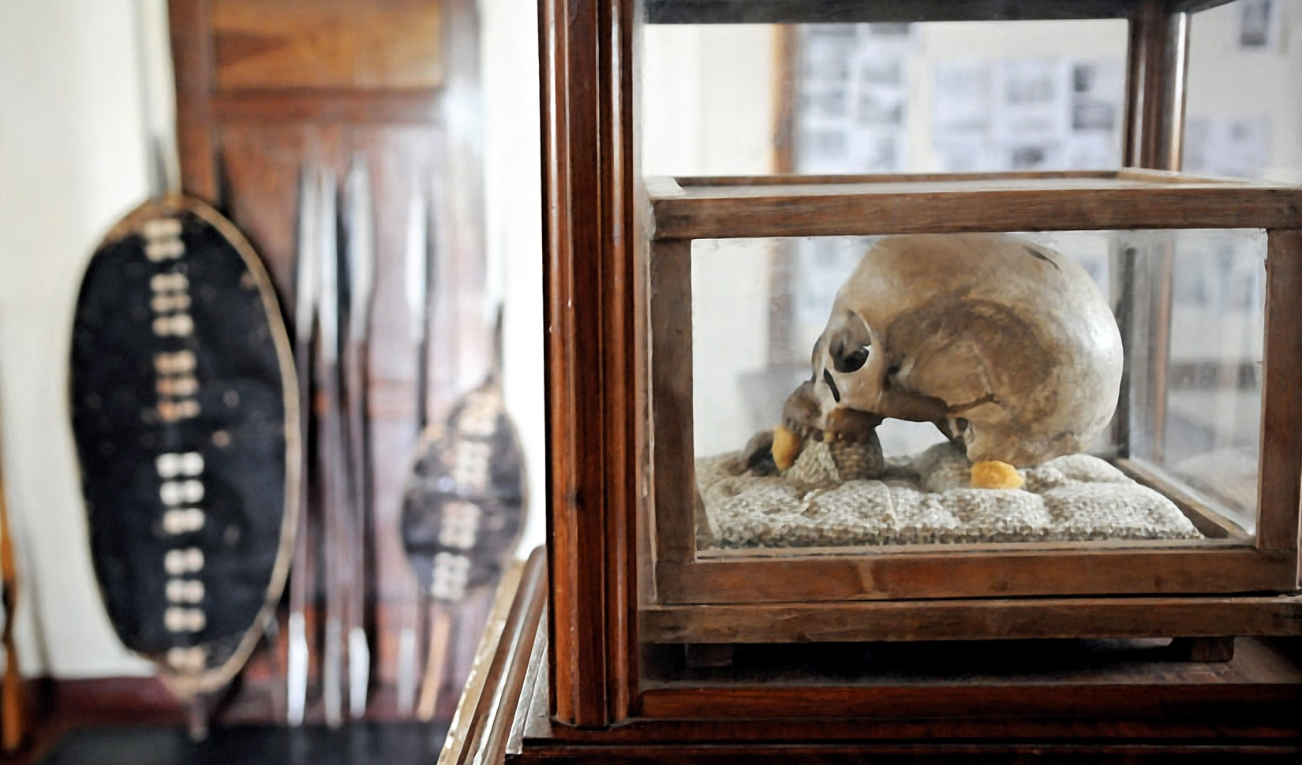

Slide 16
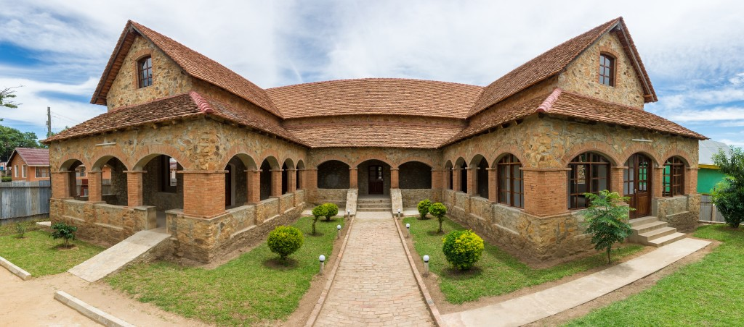

TANGIBLE SPACE CONSERVATION
IRINGA BOMA REGIONAL MUSEUM
History of the building: Hospital for Europeans (German), regional administration (British), district administration (independent Tanzania)
Restoration with EU-funding
Museum establishment in collaboration with University of Iringa, National Museum of Tanzania, European consultant
Other activities and services: Café/restaurant, conference room, cultural events

Slide 18
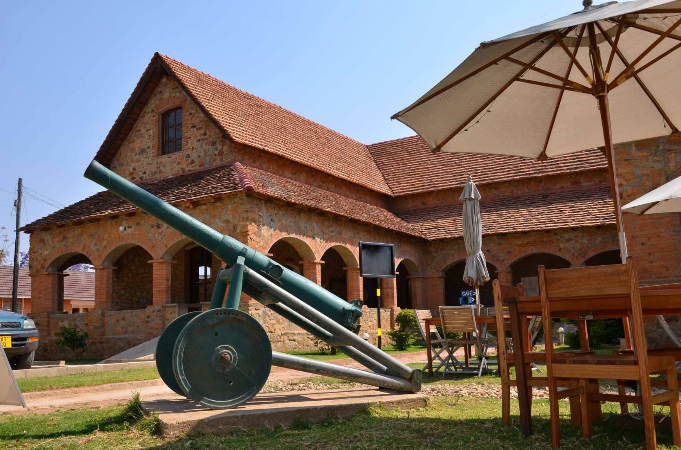

Slide 19
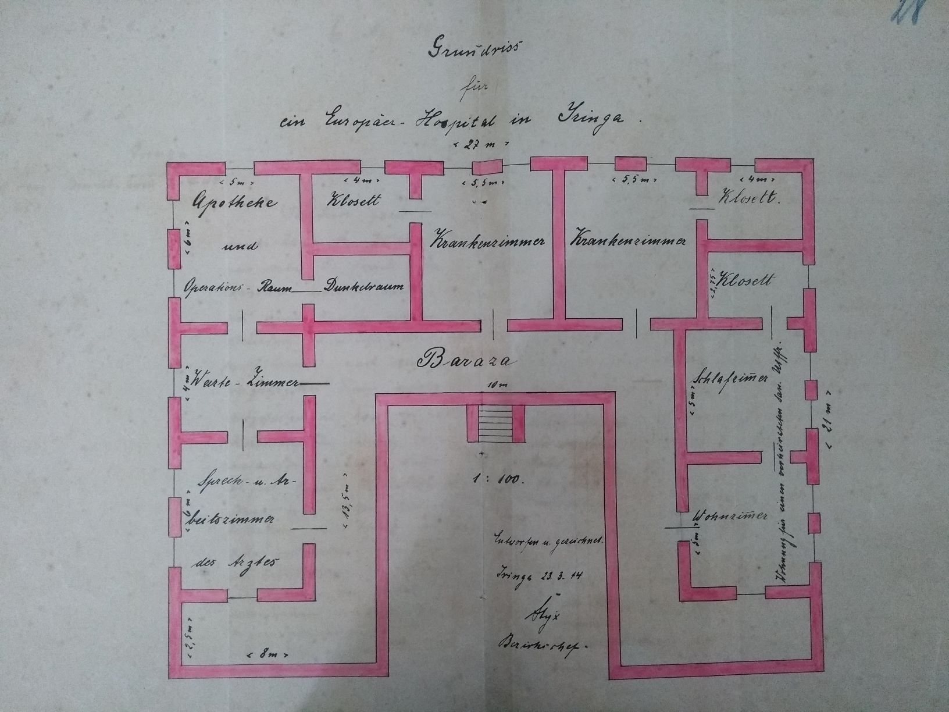

Slide 20
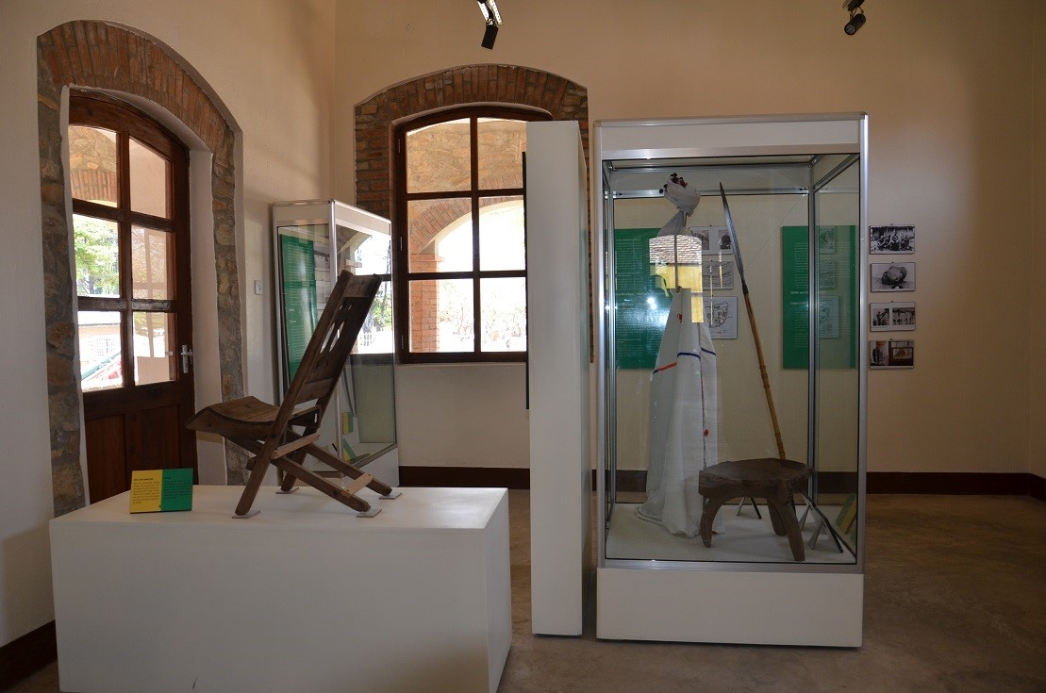

Slide 21
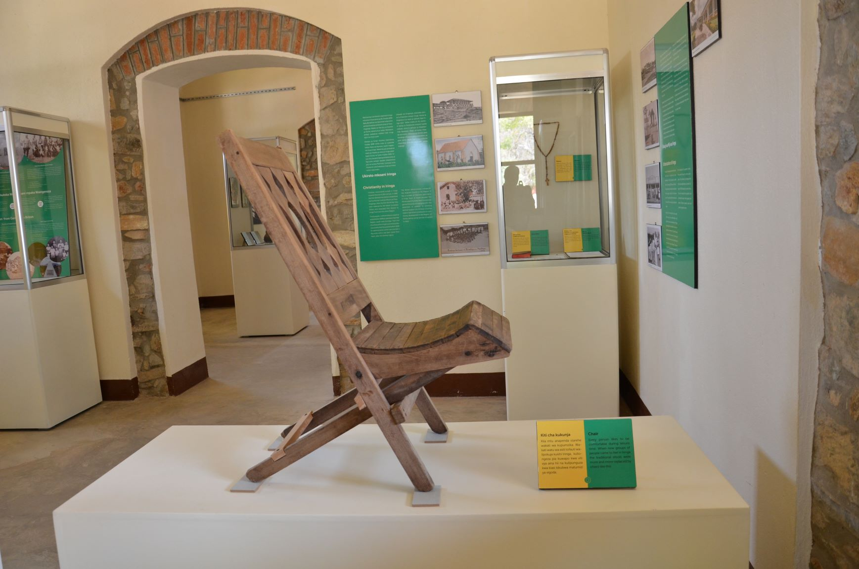

Slide 22
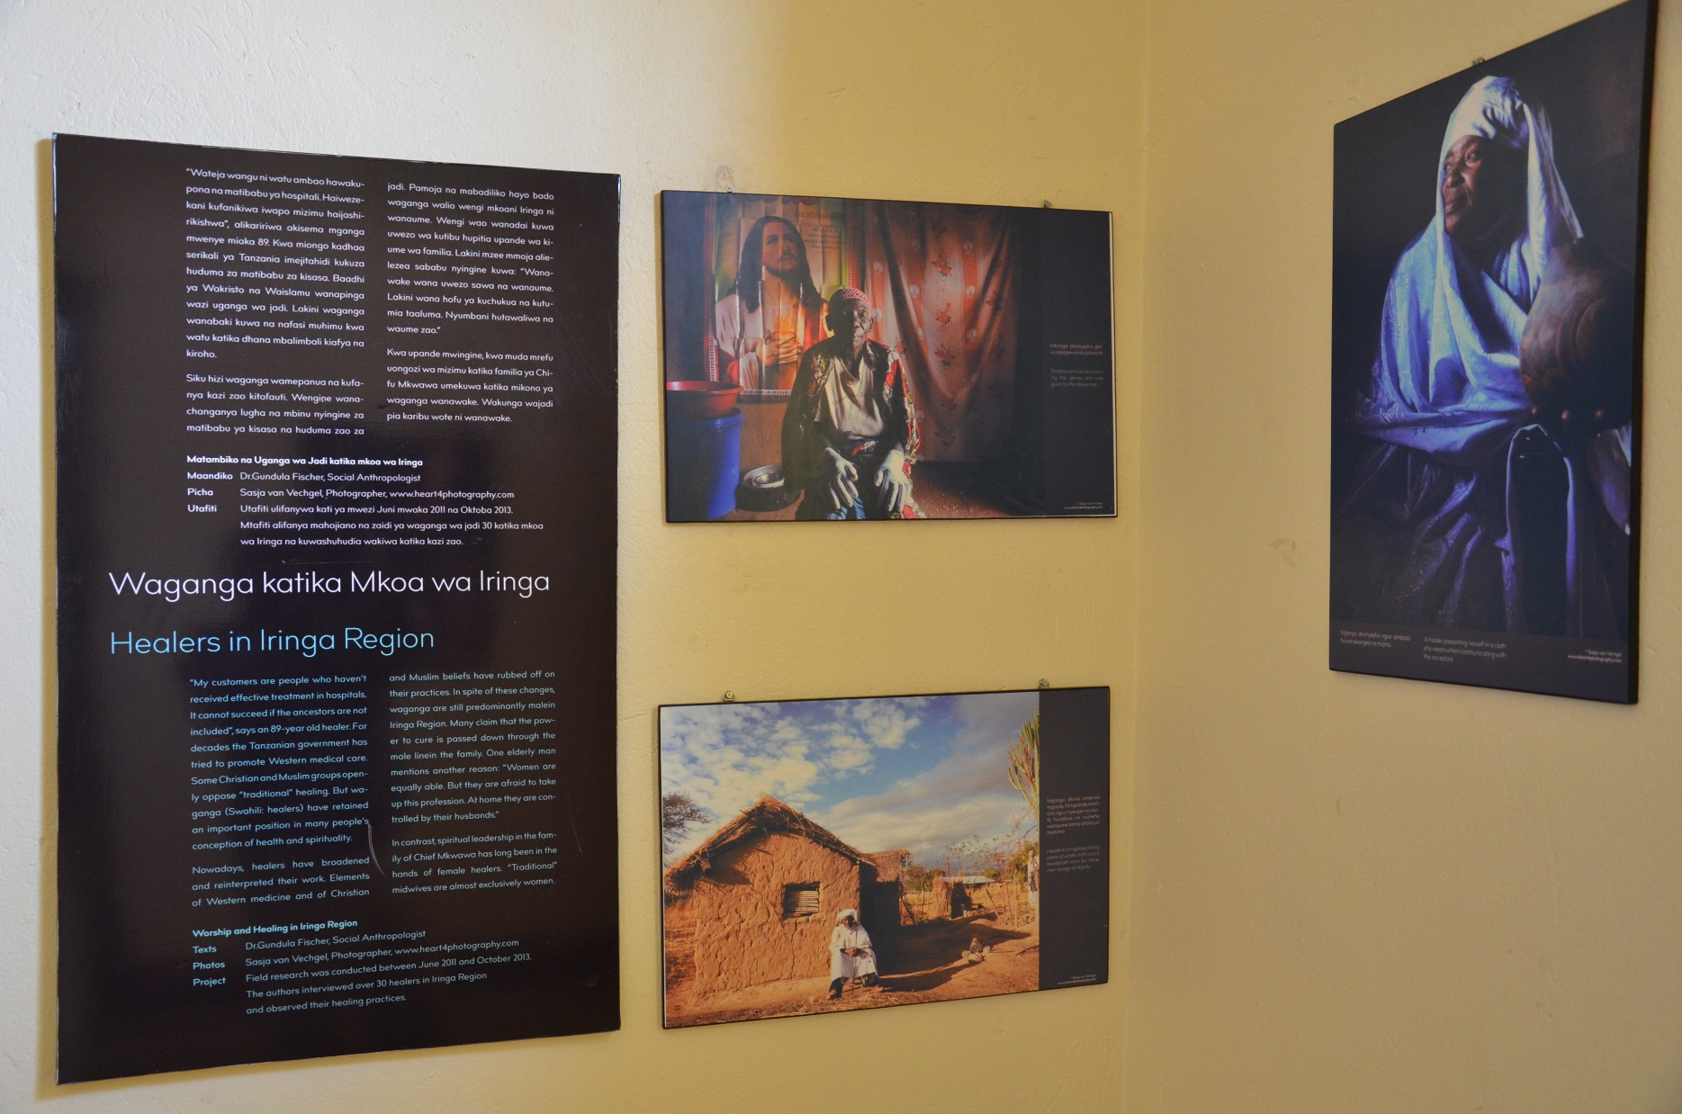

Slide 23
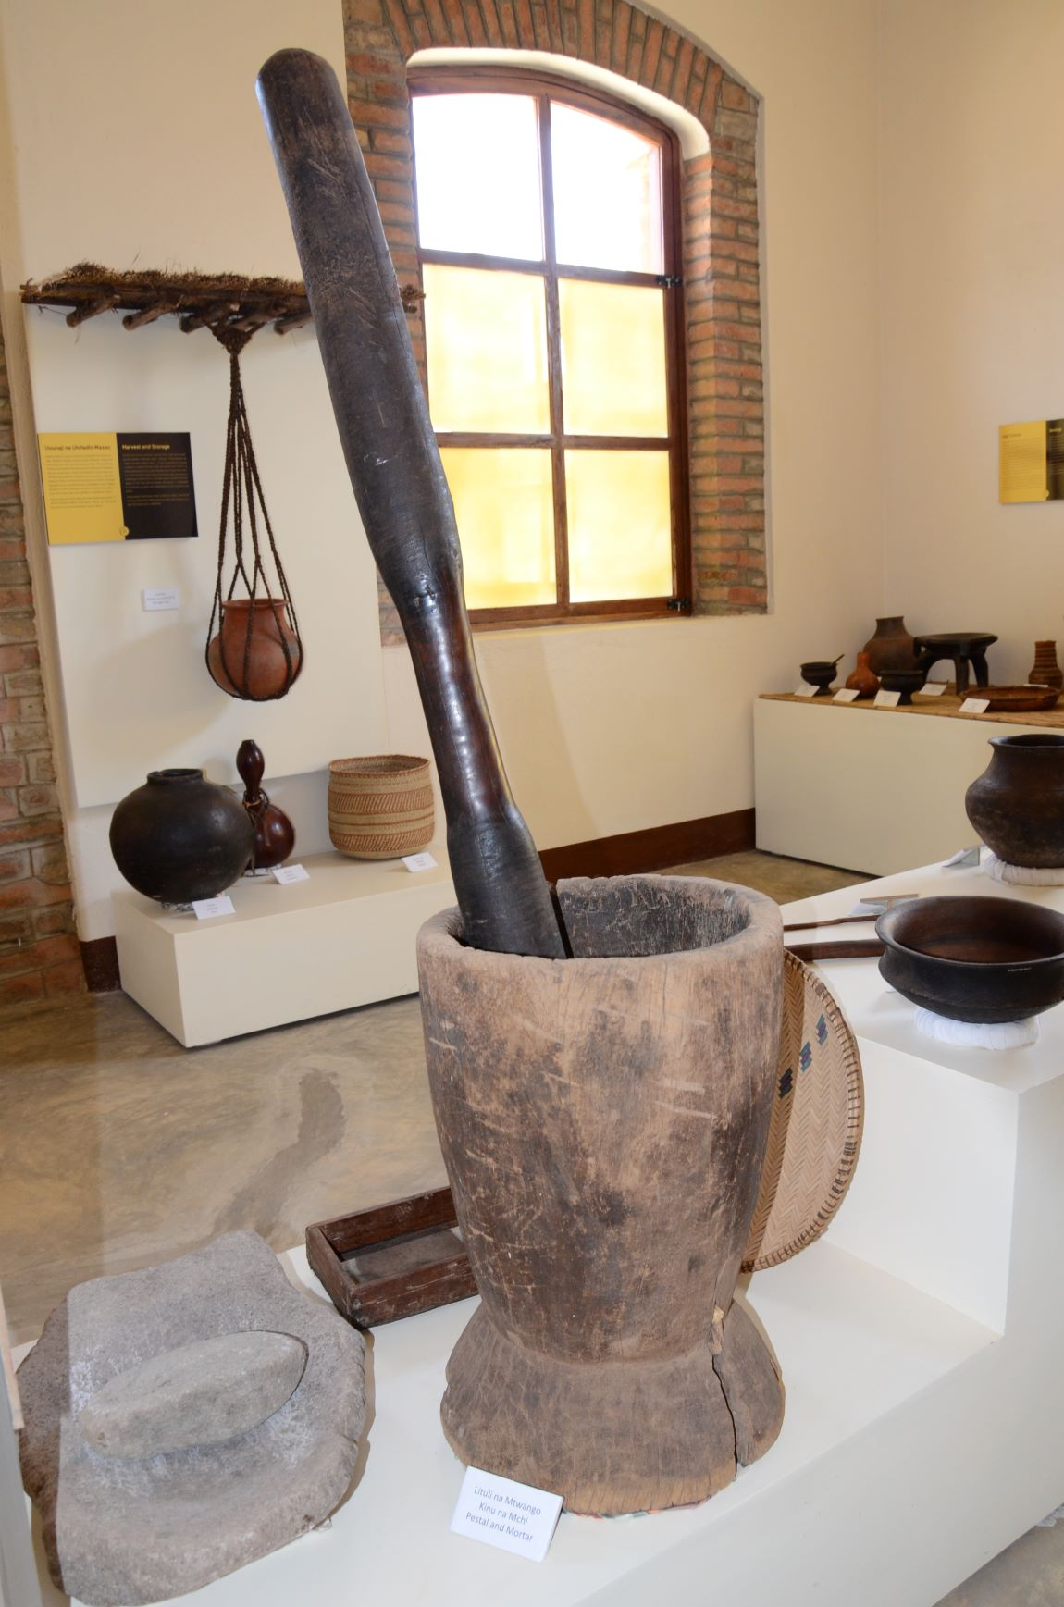

Slide 24
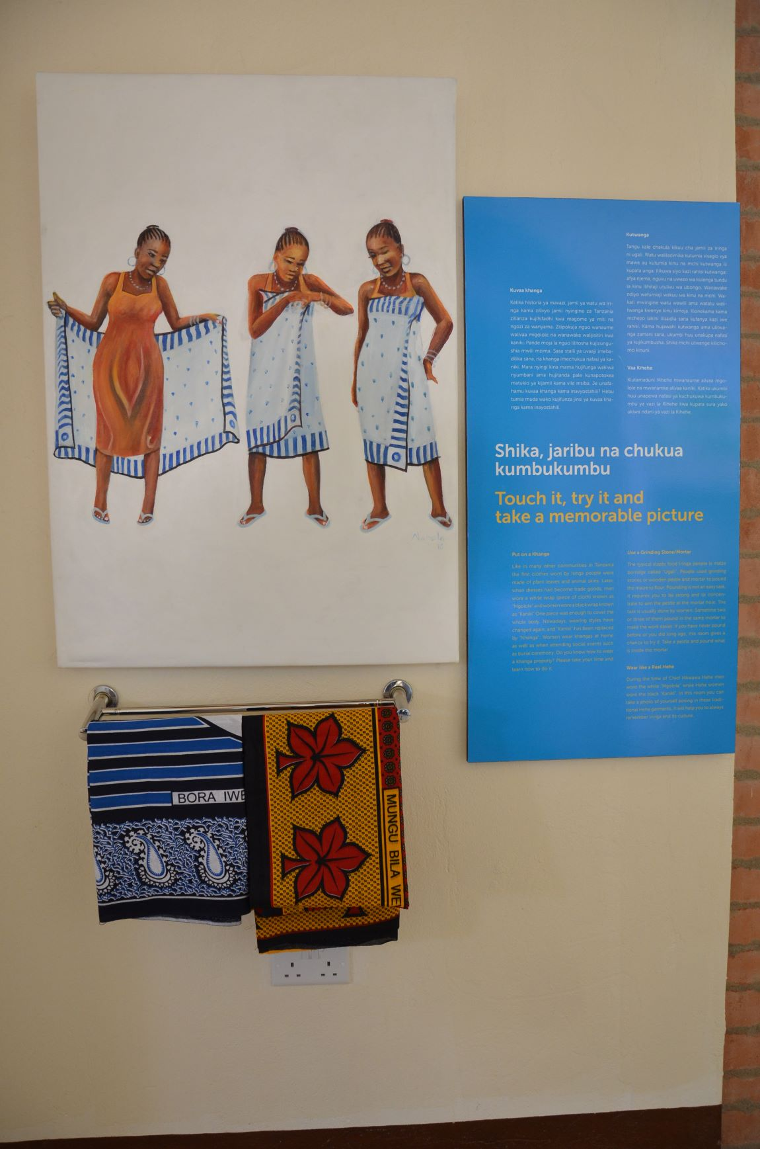

Slide 25
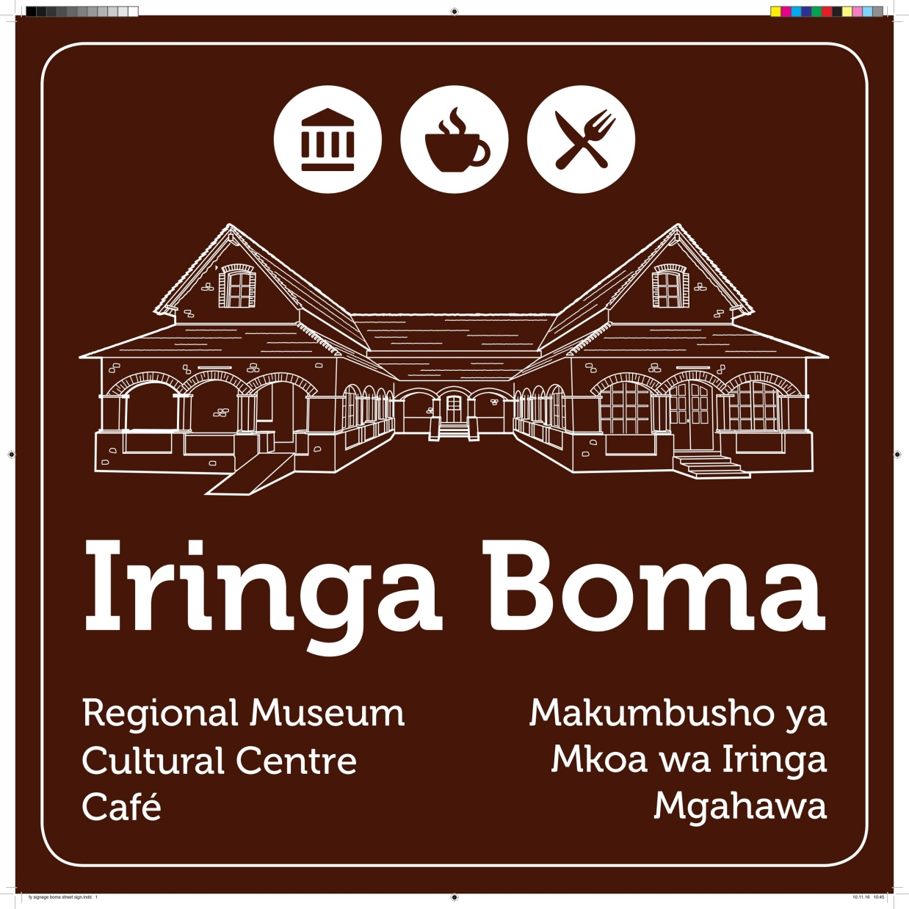

Slide 26
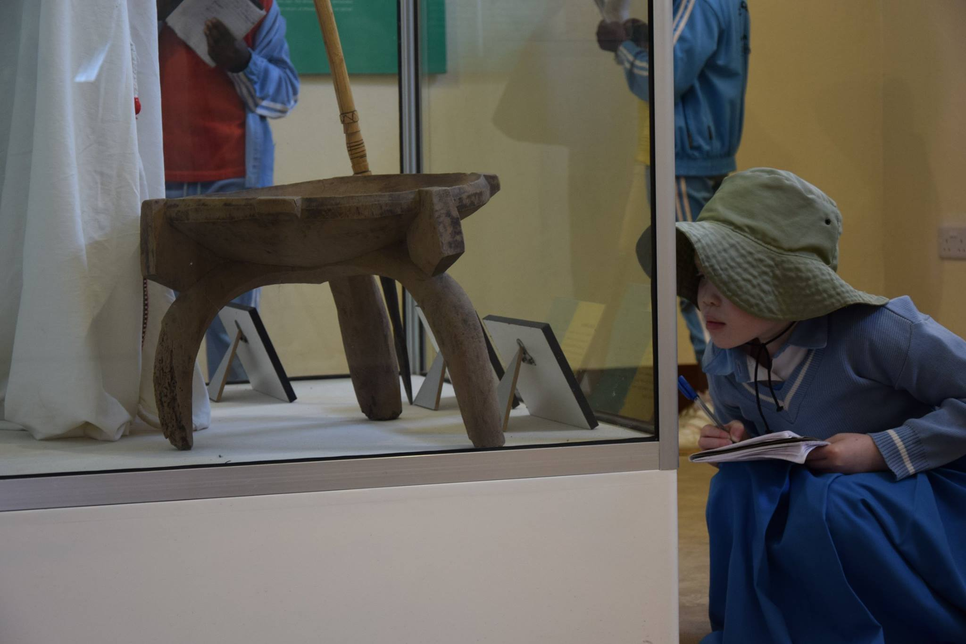

Slide 27
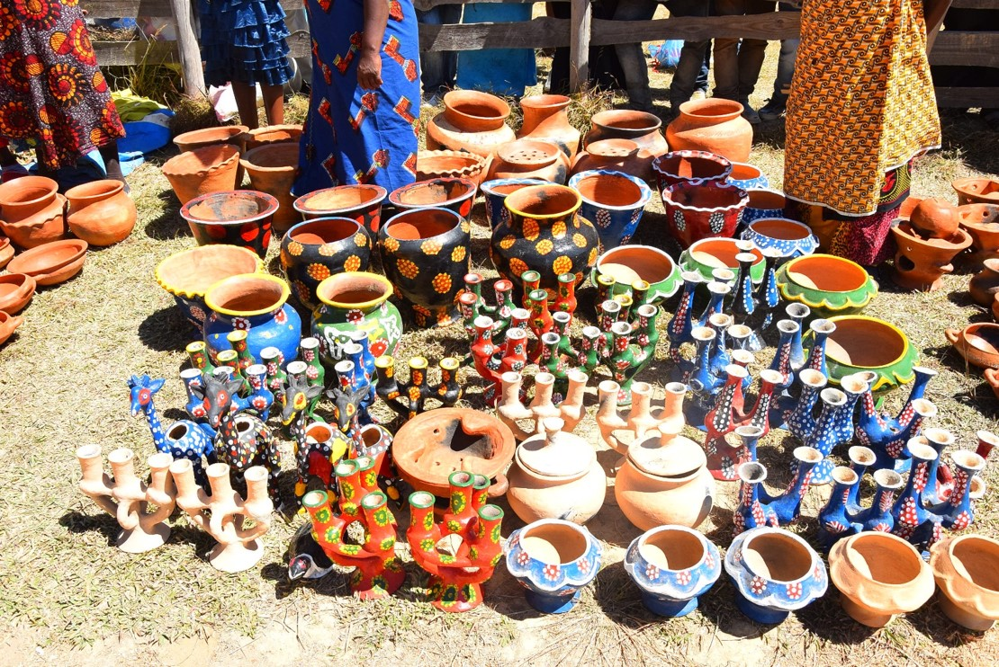
COMMUNITY CULTURE CONSERVATION
CULTURE & ARTISAN GROUPS PROGRAMME
Training, product development, business incubation, promotion & marketing (events, tours) through the Boma
Local basketry (women groups)
Local pottery (women group)
Local music and dance (mixed groups)
Environmental site conservation (mixed group)
Contemporary arts (youth initiative)

Slide 28
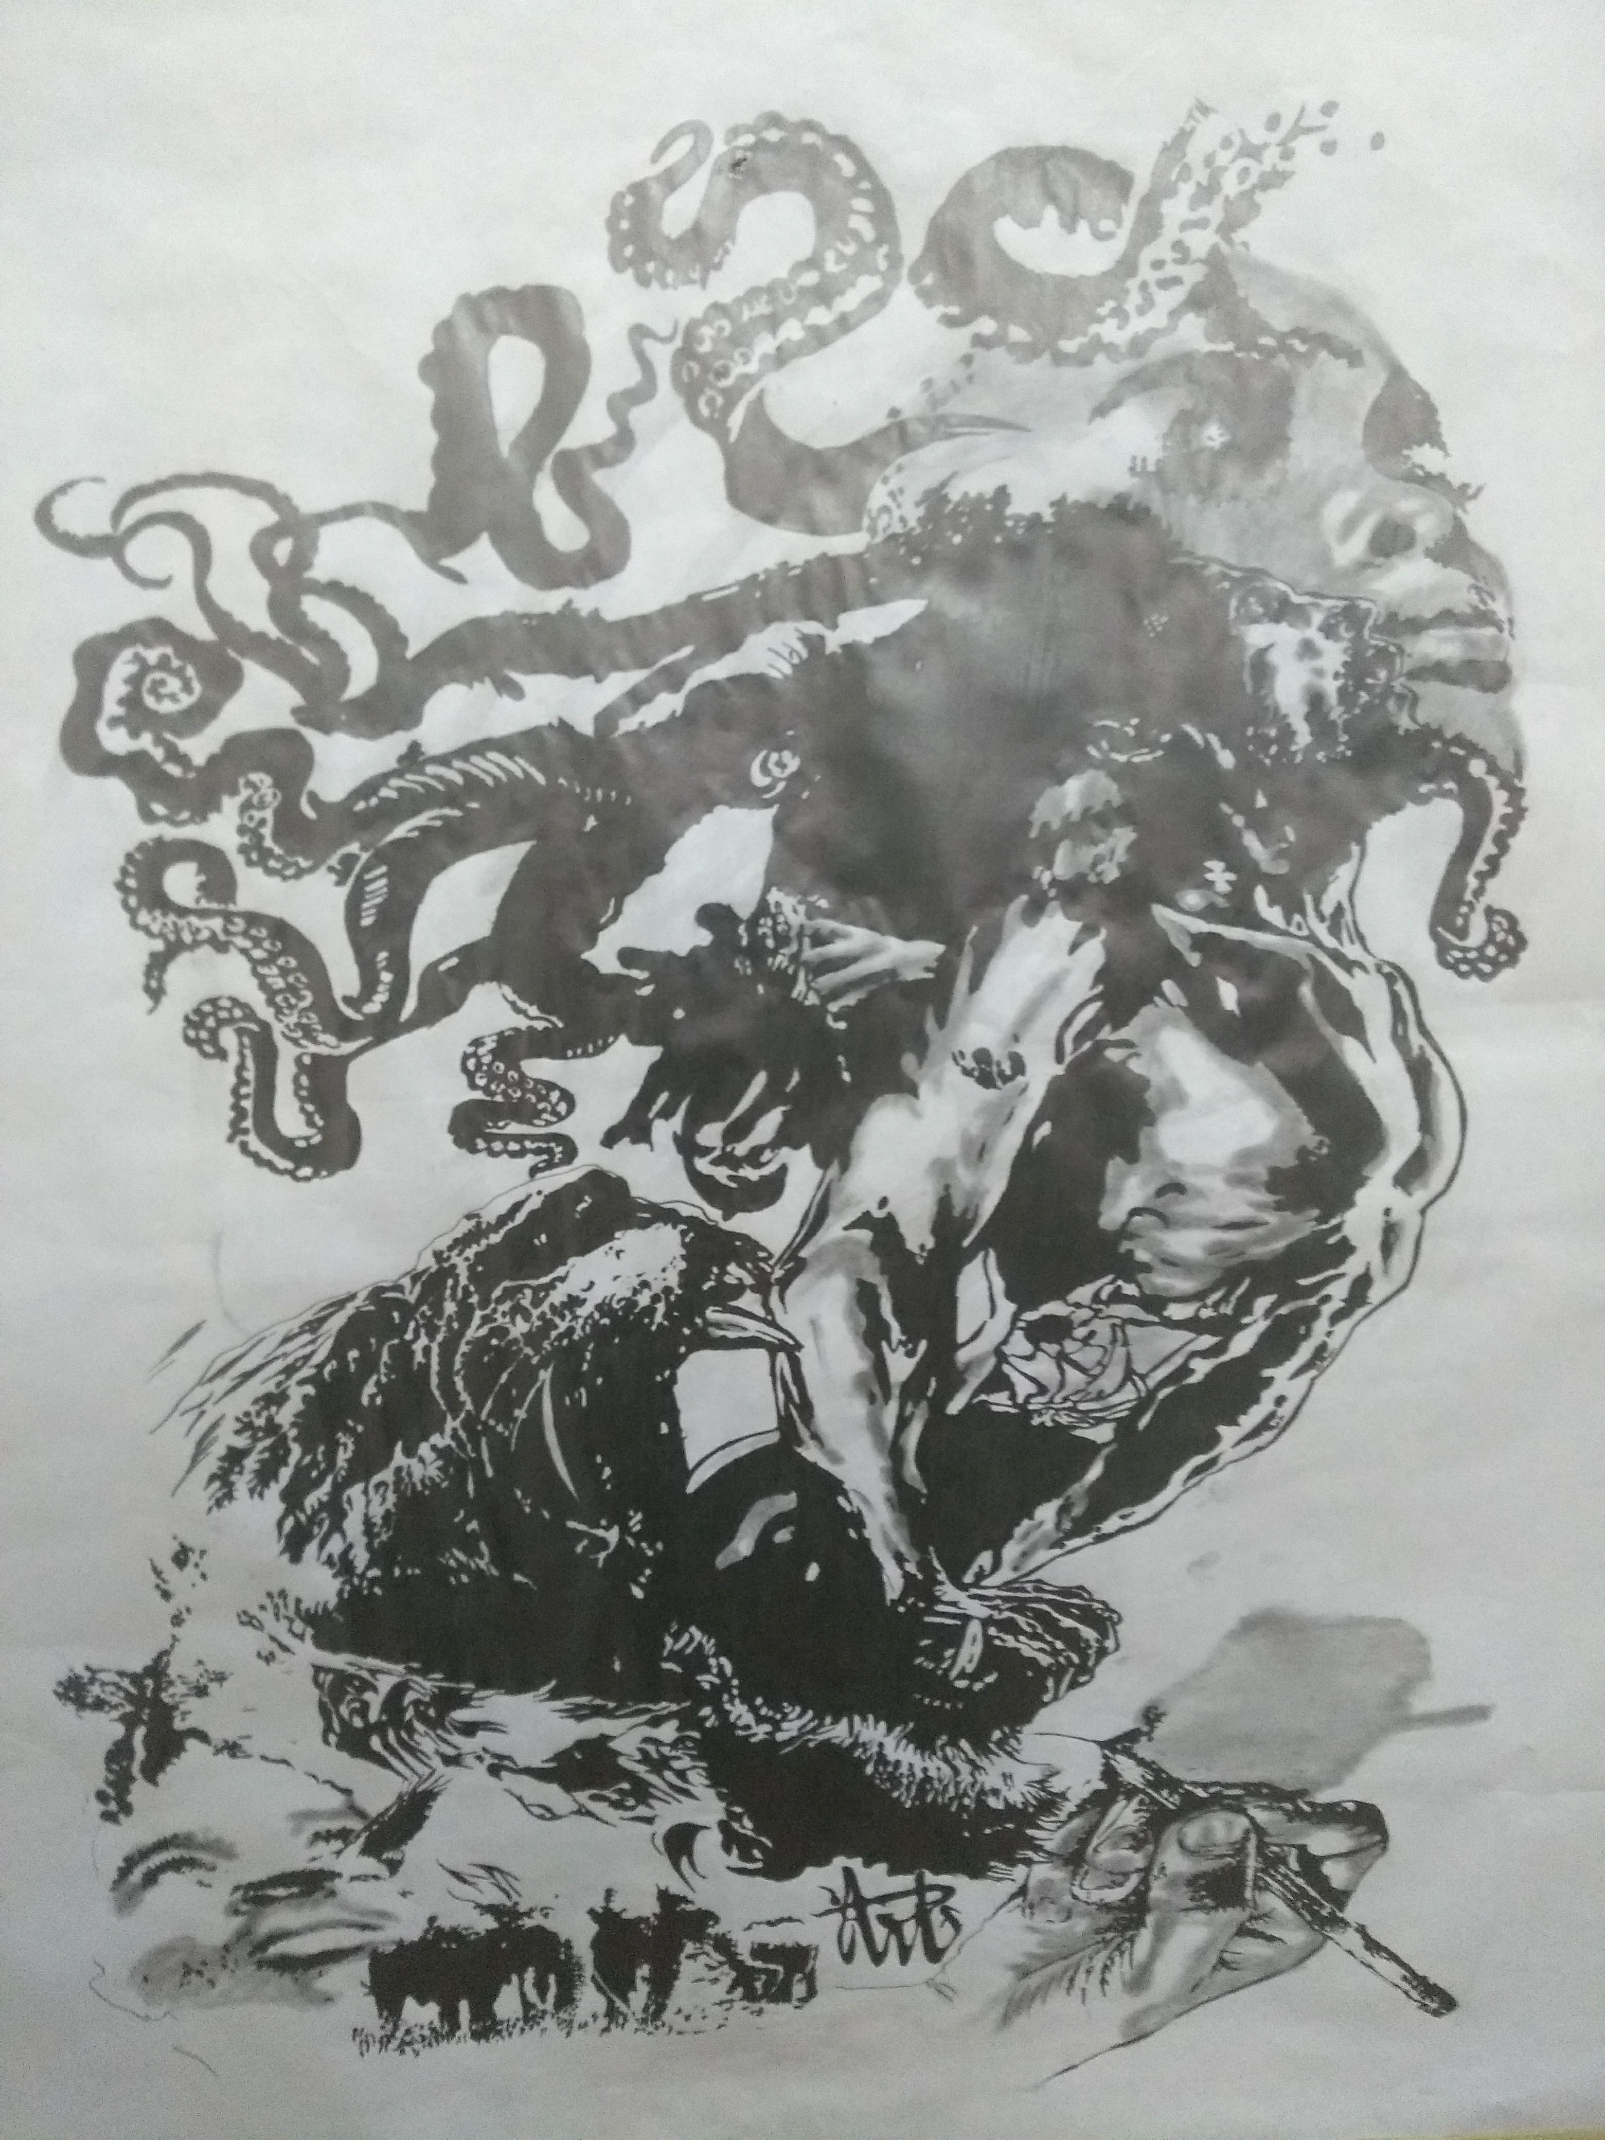
INTEGRATED CONSERVATION
„SHARED HERITAGE“ COMMUNITY CENTRE
History of the building: Sergeant‘s mess of German military station, first building of „New Iringa“ around which the town grew, police station (British), central police (independent Tanzania), vacated because of dilapidation
Restoration possibly funded by federal foreign office and Bundestagscommittee
Use options: 1. Historical hotel and guesthouse
2. Community art & culture centre: Music, pottery and
basketry workshops, recording studio, art studios, wall
and street art, psycho-social counseling facility for
domestic violence victims

Slide 29
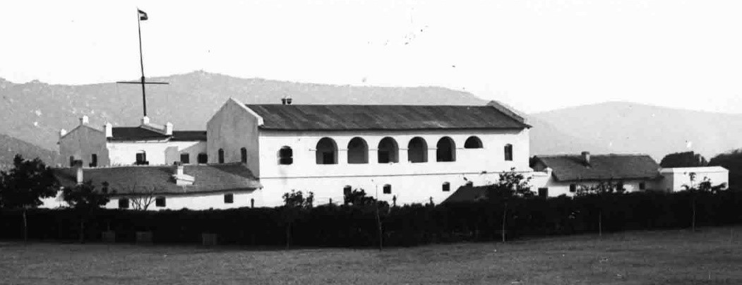

Slide 30
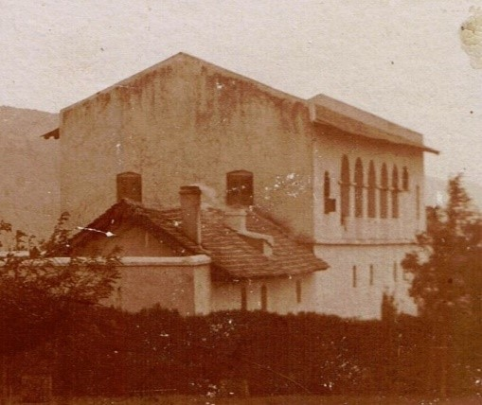

Slide 31
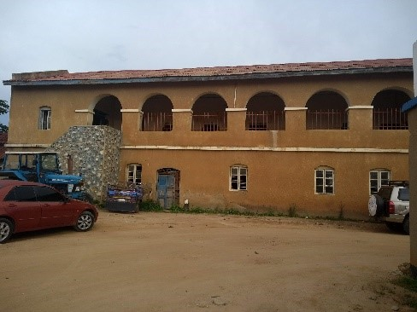

Slide 32
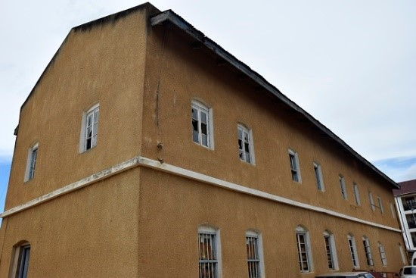

Slide 33
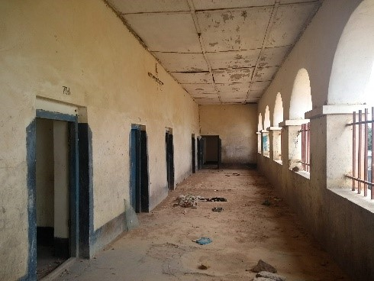

Slide 34
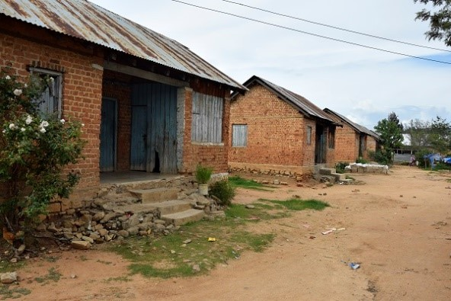

Slide 35
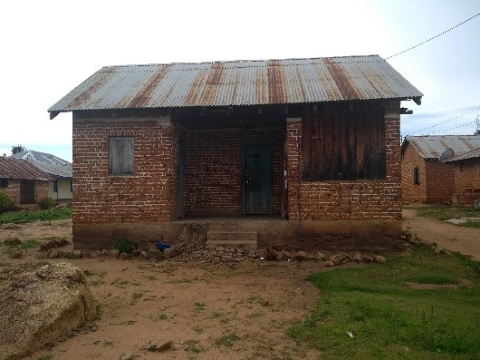

Slide 36
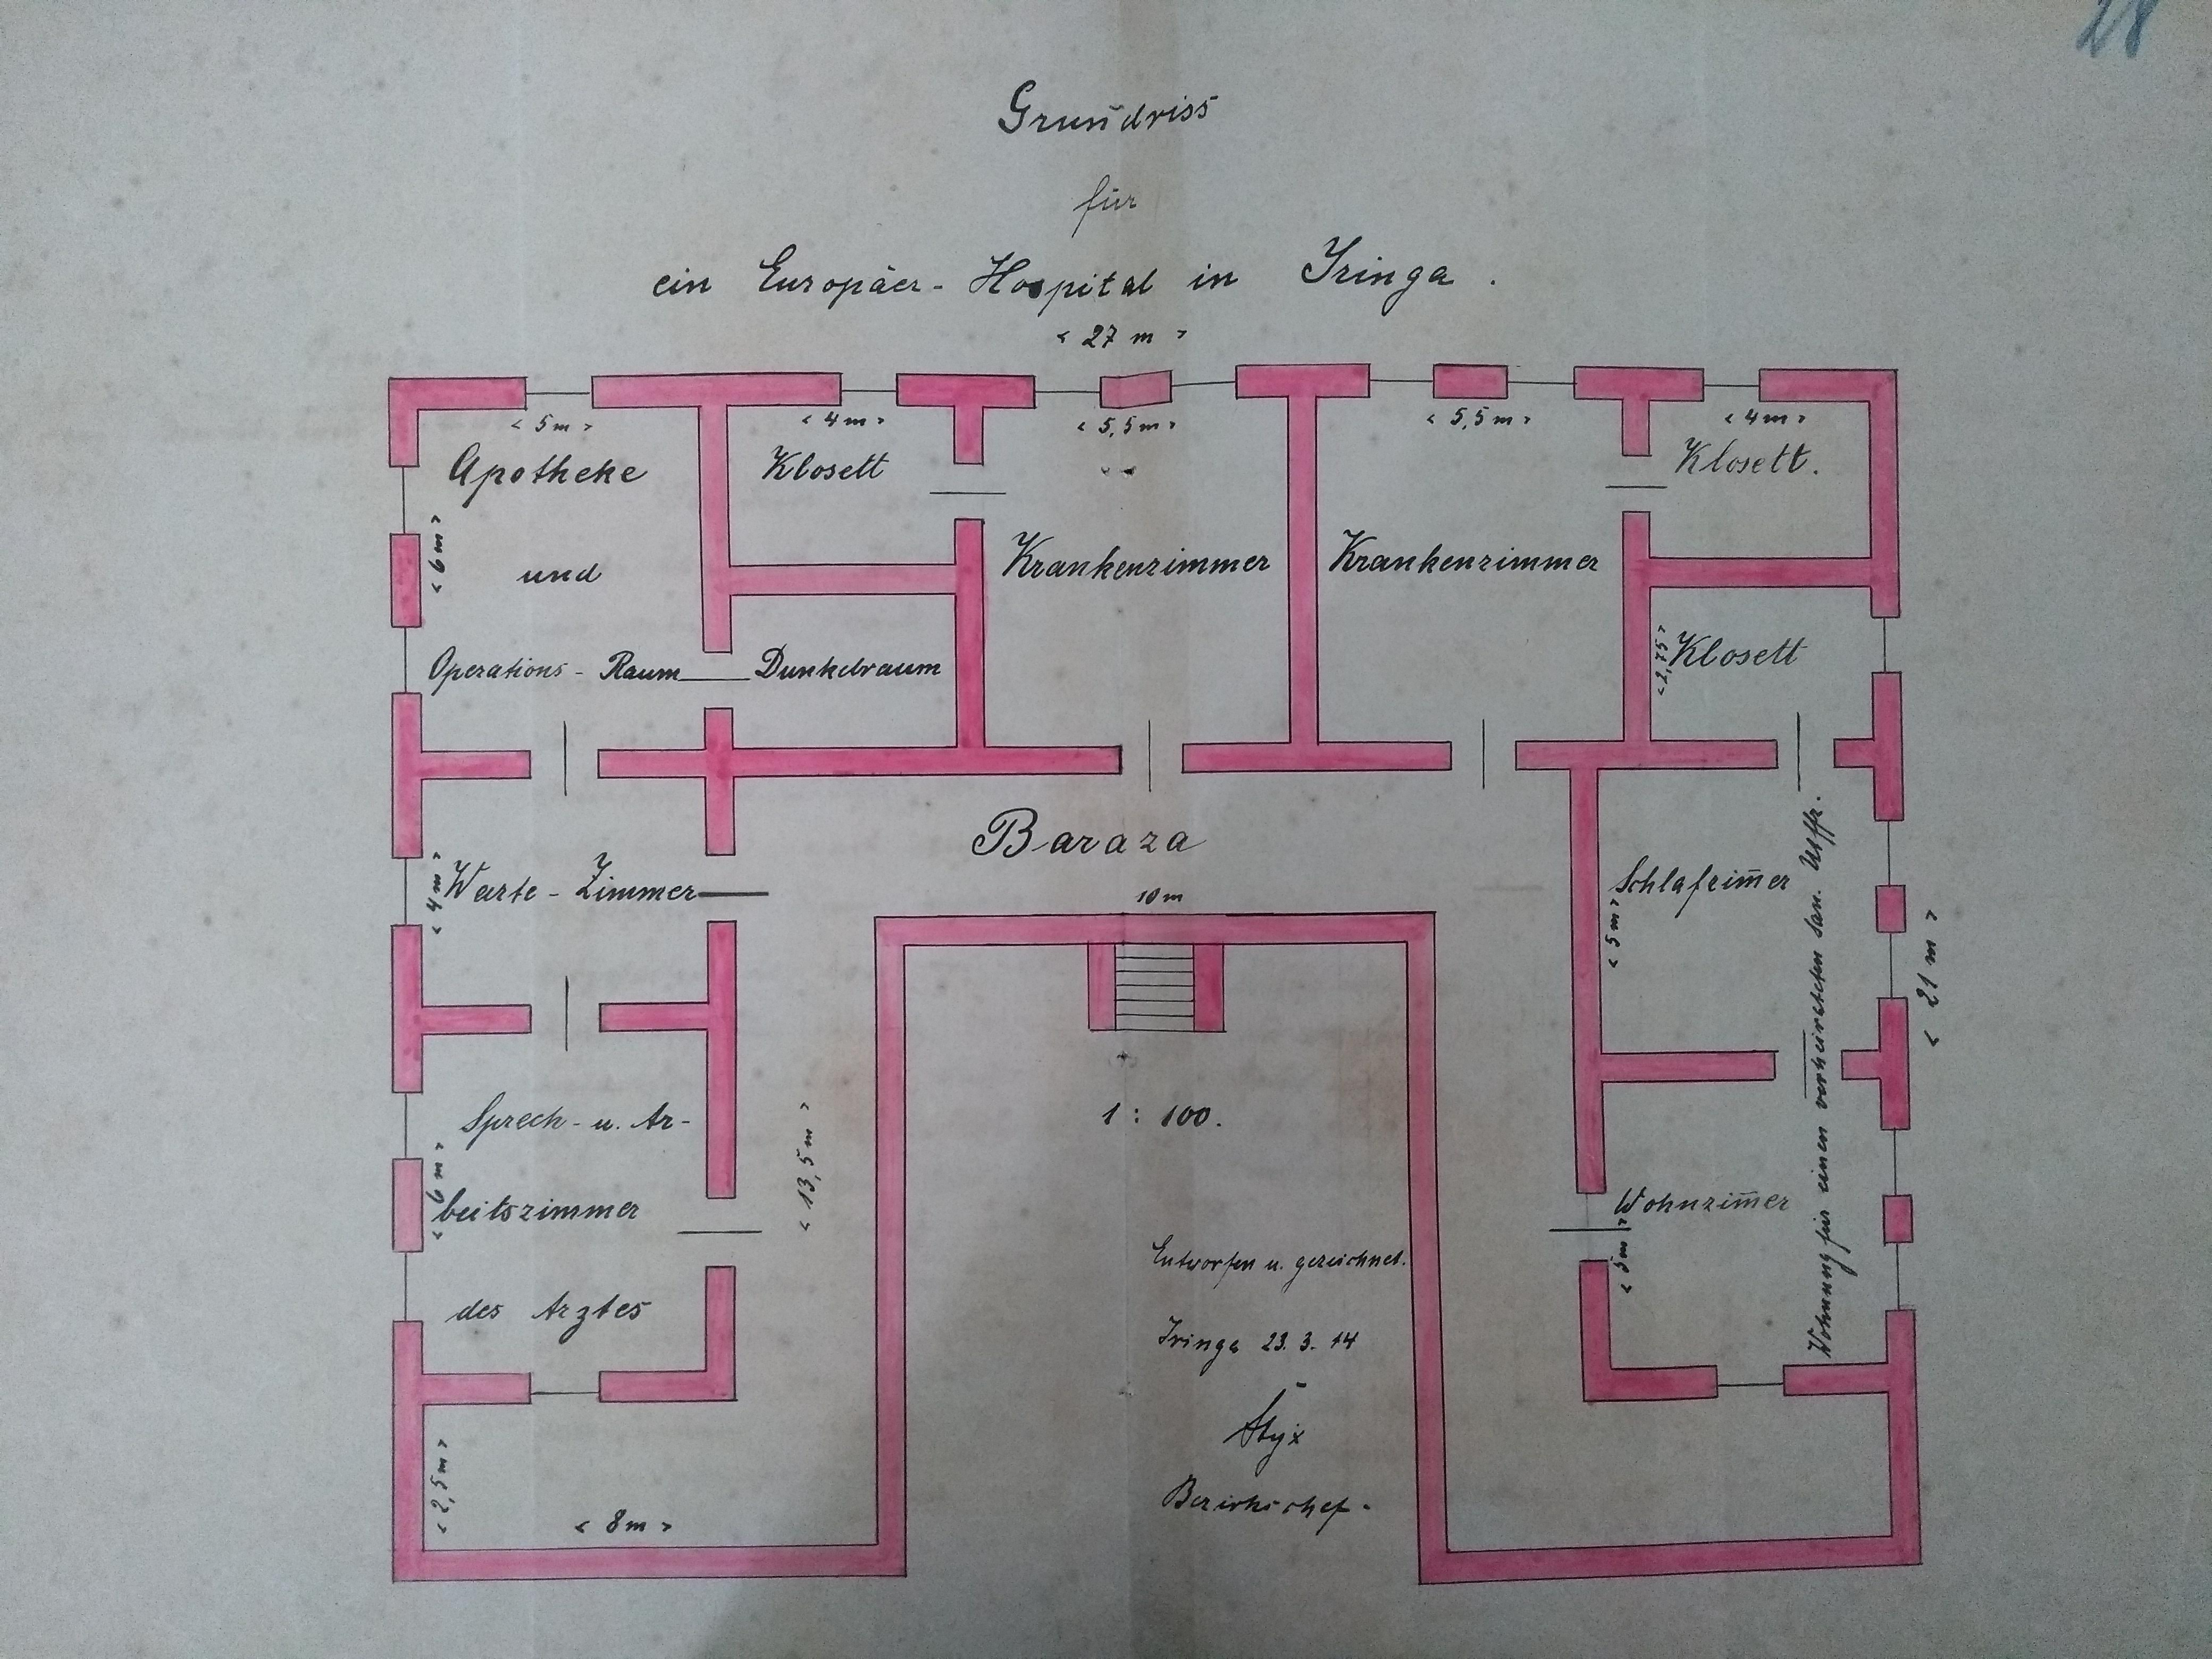
Reflections on „shared heritage“ – from its „discontents“ towards „added value“
Discontent of colonial heritage conservation: In which way does it reproduce the colonial power disparity and injustice?
„Shared heritage“ seeks address and negotiate different, often conflicting interpretations, meanings and usages of heritage objects
Participatory object management is supposed to be done by a „heritage community of practice“ >> looking for commonalities
Germans, Tanzanians and various local actors share the colonial heritage of Iringa and need to negotiate how to make use of it

Slide 37
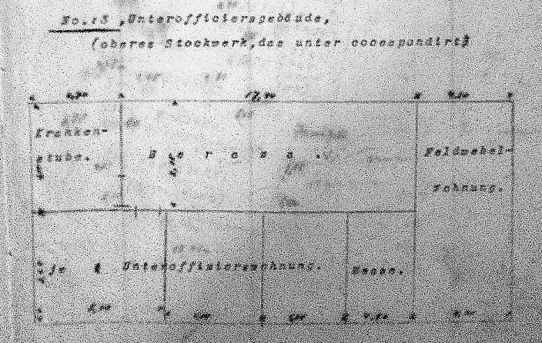
THE PRIMARY GOAL
SDG 11 – Sustainable cities and communities
Key target 11.4 - Protect the world‘s cultural heritage
Target 11.7 – Provide universal access to safe and inclusive public spaces, in particular for vulnerable groups
Target 11A – Support positive economic, social and environmental links between urban, peri-urban and rural areas
Creating community livelihoods through participation

Slide 38

SUPPORTING GOALS
Creating community livelihoods through participation
Link to SDG 1.4 – Access to basic resources and services (right to cultural resources and heritage)
Link to SDG 4.7 – Foster knowledge and skills needed to manage cultural resources and heritage, including the appreciation of cultural diversity and culture‘s contribution to sustainable development
Link to SDG 12B – Develop and implement tools for sustainable tourism that creates jobs and promotes local culture and products

